Slide 1


HCC Totality Training
New Supplier

Slide 2
Training Agenda
Totality Overview
Totality Importance
Roles and Responsibilities
Compliance Requirements
Totality Resource
Supplier Navigation
Data Template (Download & Completion)
HCP Search & New HCP request
Data Integrity on template uploads
Upload (Document & Template)
Errors (Notification/Validation/Correction)
Activity Report and Close out
Upload Review and Data Deletion

Slide 3
Totality Overview
Totality is a centralized data management system that provides review and approval of projects involving value exchange with Health Care Professionals/Providers (HCPs), Customers, and Medical Institutions
Scope: All payments made to HCP’s from a U.S. Johnson & Johnson budget
Prescribers | Doctors, Nurses, Practitioners, Physician Assistants
Acquires | Hospitals, Health Systems, Procurement Professionals, Clinics, Managed Care Organizations, Pharmaceutical Benefit Managers (PBMs), Group Purchasing Organizations (GPOs), Formulary Committee Members, Purchasing Agents
Influencers | Medical Administrators, Universities, Purchasing Agents, Formulary Committee Members, Nurses, Health Economists, Key Opinion Leaders (including Scientists and/or PhDs), Medical Societies, Advocacy Groups, Commercially contracted customers and their subsidiaries (e.g., Medco/UBC)
Two Instances of Totality:
Internal Portal: Review & approval – provide visibility to all documentation & value exchange uploaded by suppliers.
Supplier Portal: Used by suppliers to upload value exchange data and required compliance documentation
Why Use Totality?
Supports transparency initiatives and federal/state reporting requirements.
Central repository for maintaining compliance documents in support of HCP transactions.
Unique J&J HCP ID # used to track and report all HCP value exchange

Slide 4
J&J HCP ID for Reporting
J&J HCPID is a unique identifier for the J&J. J&J HCP ID is used to aggregate value transfers to a Practitioner from multiple data sources (Procurement, Concur and third Party Data)
HCP Heavy
Full data add process with data matching & unique identifiers for Individual HCPs and Institutions who are required to meet statutory and voluntary requirements which are subject to full HCC and business policy controls. Outside US Institution.
  J&J ID is required for all Practitioners, Mid-Level Practitioner, Institutions, Nurses and Pharmacists in MA, DC, VT, NV
HCP Light
Simplified data add process for individuals still subject to internal audit reporting and full HCC and business policy controls. Individuals outside of the US.
  No need to assign a unique J&J ID number from the Customer Master system.
  Examples include: non-reportable attendees or consultants (office admins, etc.)

Slide 5
HCP Reportable & Non Reportable
Recipient Profession | Recipient Job Classification | Reportable – General | MA, DC, VT, NV
Practitioner | -MD – Medical Doctor -DCM – Doctor of Chiropractic Medicine -DMD – Doctor of Dental Medicine -DDS – Doctor of Dental Surgery -OD – Doctor of Optometry -DO – Doctor of Osteopathy -DPM – Doctor of Podiatric Medicine -DVM – Doctor of Veterinary Medicine -Resident | Yes | Yes
Pharmacist | -Pharm D – Doctor of Pharmacy -RPh – Registered Pharmacist | No | Yes

Slide 6
HCP Reportable & Non Reportable
Recipient Profession | Recipient Job Classification | Reportable – General | MA, DC, VT, NV
Mid-Level Practitioner | -APRN – Advanced Practice Registered Nurse -NP – Nurse Practitioner -PA – Physician Assistant | Yes | Yes
Mid-Level Practitioner | Dental Therapist | No | Yes
Nurse | -BSN – Bachelor of Science in Nursing -LPN – Licensed Practical Nurse -RN – Registered Nurse | Yes | Yes
Other Professional | -PhD – Doctor of Philosophy -PsyD – Doctor of Psychology -Optician -Counselor -Social Worker -Technician -Student -Non-licensed Other Professional -Administrative Staff | No | No

Slide 7
Why is Totality Important?
Totality
J&J’s system-of-record for value exchanges made to Healthcare Professionals (HCPs)
A critical control mechanism for J&J’s Healthcare Compliance (HCC) program.
Vital to J&J’s compliance with Federal Open Payments Regulations
Open Payments (“Sunshine Act”)
Program implemented in accordance with physician and teaching hospital payment reporting provisions of the Affordable Care Act (ACA) of 2010
Requires health care manufacturers to report to the federal government certain payments and other exchanges of value (e.g. food and beverage, travel expenses) provided to U.S. Healthcare Professionals (HCP) and U.S. teaching hospitals.
Information is then posted by the government on a public Web site
Open Payments Impact
Tight timelines for Johnson and Johnson to prepare reports for submission requires all information be uploaded ON TIME
Information in Totality will be used to compile the Open Payments reports, as well as other disclosures such as state reporting and company transparency reports
Inaccurate information may result in non-compliance with applicable laws and potential penalties for our company and lead to the dissemination of inaccurate information to the public regarding our payments and other value transfers to HCPs.

Slide 8
Roles & Responsibilities
Supplier
Ensure Executed contract & J&J PO is in place before work begins
Completion of annual HCC & Totality Training
Understand compliance requirements
Ensure systems and processes capture required data/deliverables
Uploading data & deliverables
All value transfer MUST be uploaded. (Heavy and Light)
Validation of data
Attest when deliverables are complete
Complete, Accurate, and Timely Completion of Tasks
Required documentation by project completion
    Project Deliverables/Proof of Service
    Dually executed J&J HCP agreement
    Verification Checks – Required for all US HCP’s
    Upload dated screenshot for OIG/EPLS/State License checks
    Any additional documentation required by your J&J Project Manager
J&J Project Owner
Program initiation for internal HCC review and approval
Execute supplier contracts
Ensure supplier is aligned with compliance deliverables
Review of deliverables and uploads to ensure completion & accuracy
Closing the project

Slide 9
Compliance Requirements
Four key elements that internal project owner must provide for a clear audit trail:
  Legitimate Business Need
  Fair Market Value
  Written Contract
  Evidence of Services Performed
Required documentation by project completion
  Project Deliverables/Proof of Service
  Dually executed J&J HCP agreement
  Verification Checks – Required for all US HCP’s
    Upload dated screenshot for OIG/EPLS/State License checks
  Any additional documentation required by your J&J Project Manager

Slide 10
Compliance and Upload Requirements
Data Template Upload Timeline Requirement:
  One-Time events – 30-days after project completion
  High Volume projects/events – Monthly (30-days after month close)
  All other projects that span across the year – Quarterly (30-days after quarter close)
REMINDER: Q4 data is always due January 30, 20XX. Anything uploaded after the due date is considered “Late Data” and subject to government penalties.
Data Template Upload Timeline Requirement:
  Totality Project Deliverables/Closeout Requirements
  Totality Closeout Requirements - Pharmaceuticals
Please reach out to your J&J Project Manager or Totality Expert for the respective sector that you’re working with.

Slide 11
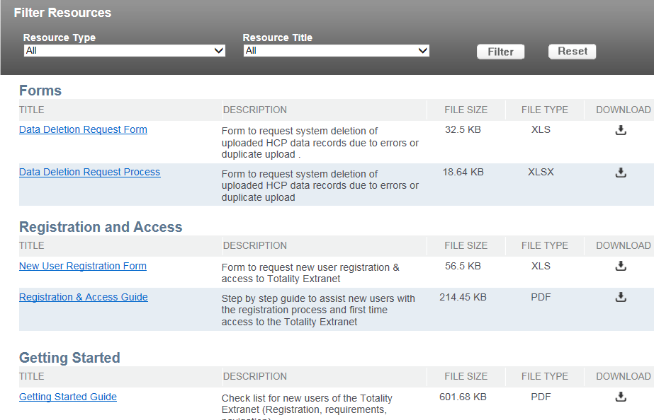
Totality Supplier Resource Site
Supplier Totality Process flow
Key Information
Registration & Access
New User Registration Form
Registration & Access Guide
Getting Started & Training
Check list for Totality Users
Recorded Totality Overview Training
Other Information Available:
Additional Training Documents, Forms, Compliance Deliverables, Reference Guides, and Report Instructions
To view these resources, visit: http://www.totalitygatewayresources.com/

Slide 12
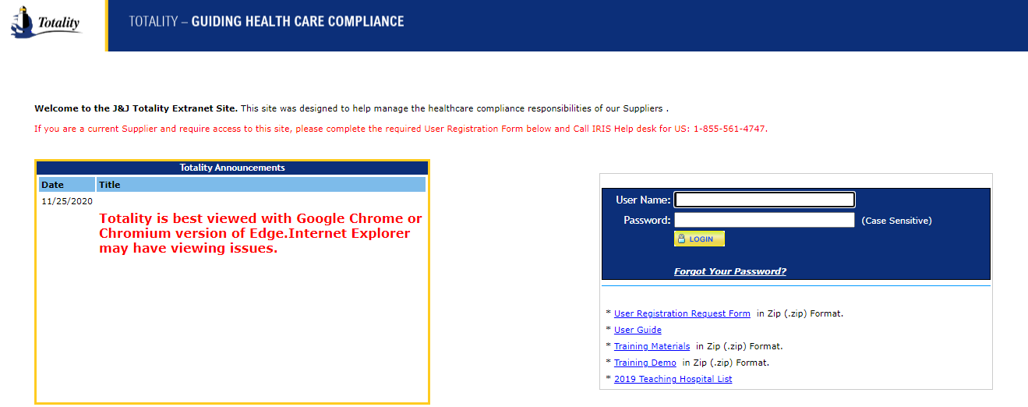
Supplier Login
Key Points:
New users will need to complete and submit the ‘User Registration Request Form’
  Upon completion you will receive a welcome email with login information (User Name = Email Address)
Once you login, you will be asked to verify your Supplier Name & Supplier Number.
  You can obtain your J&J Supplier Number from a Purchase Order, Check, or your J&J Project Manager
If your account is inactive, email: TG@PRDUS.jnj.com to reactivate your account.
Totality is best viewed with Google Chrome or Chromium version of Edge. Internet Explorer may have viewing issues.
To access the site, visit: https://totalitygateway.jnj.com
Enter User Name (Email) & Password – Select Login
Latest News & Announcements
STEP - 01
Getting Started Information – Request Form & Training Materials

Slide 13
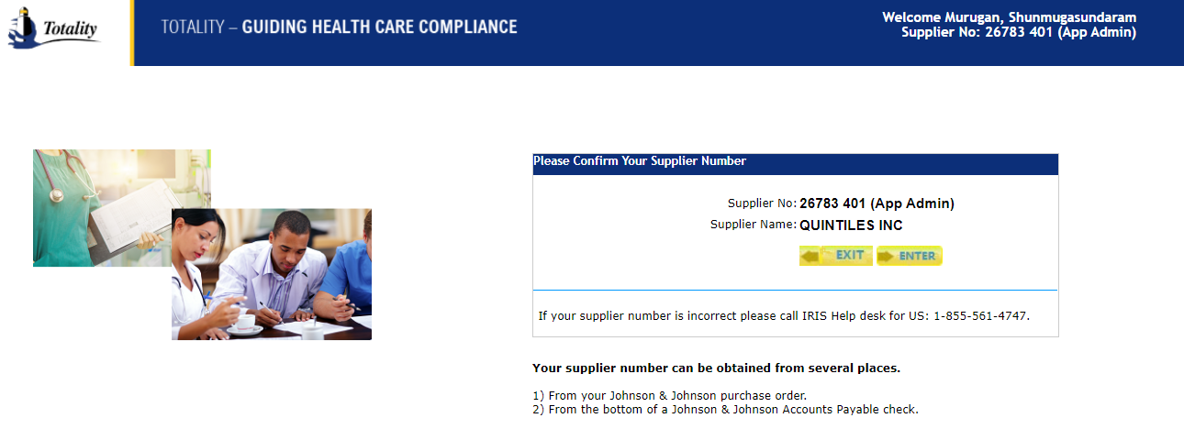
Supplier Homepage

Slide 14
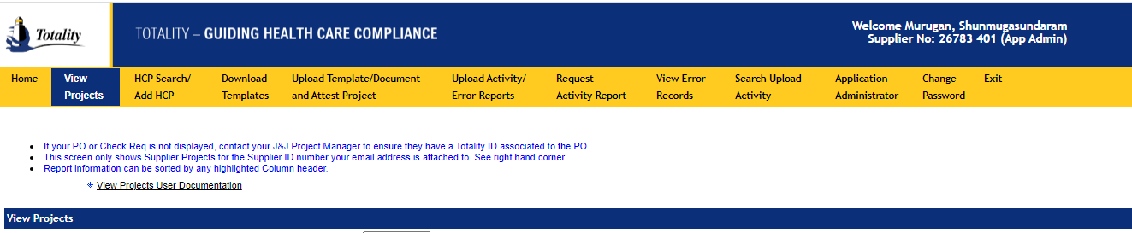
Homepage Menus
Click to view all “Active or Closed” Projects
Click to Search for HCP (HCP ID) or request to add a new HCP
Click to upload data templates, compliance documents, and to complete project attestation
Click to download data templates to upload data requirements
Click here to request an activity report to view data upload activity.

Slide 15
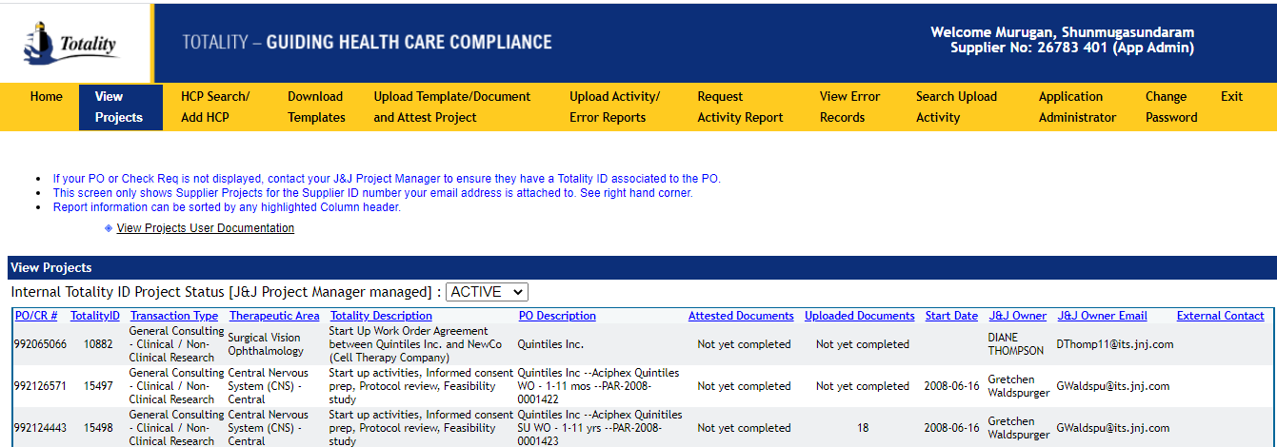
View Projects
Click to filter on Active or Closed Projects
Key Points:
Ability to view all Active & Closed projects associated with your supplier ID
Ability to view all Purchase Orders associated with an individual Totality ID Number
Note: If the PO or CR number you entered does not show up in your list, contact your J&J Project Owner to ensure there is a Totality ID associated with your PO or CR number

Slide 16
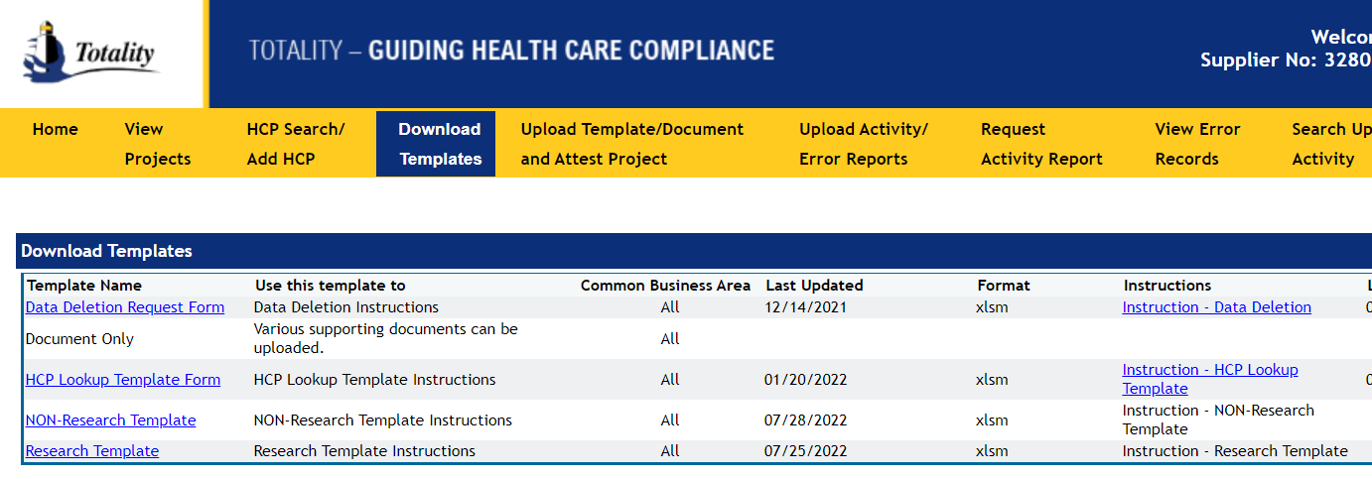
Download Data Template
Instructions for Completion
Template Name, When to User, and Common Business Areas
Key Points:
Make sure to select the appropriate Data Template type
Instructions can be found under the “Instructions” column by selected the blue link associated with each data template
Visit the Supplier Resource Site under “Instructions & Reference Guides” for detailed instructions

Slide 17
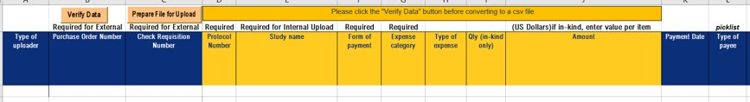
Completing Data Template
All Data Templates include two buttons to perform the following functions:
Verify Data: Performs validation for required fields and formatting errors
Prepare File for Upload: Performs validations & converts the data into the required CSV format
NOTE: Be sure to change your Excel security settings to “Allow all Macros” – you will not be able to perform the validations/upload without.
Pick List: Available for certain required fields – ability to select data from a list
Purchase Order/Check Requisition is required and must be linked to a valid Totality ID
Note: Only One PO/CR per template
Title Bars:
Names of required fields for data upload (all fields are required unless otherwise noted
Roll Over column heading for general instructions
Note: All HCP Payments must be associated with a J&J HCP ID

Slide 18
Completion of Templates
All fields are required for each line item, including the PO or CR #
Only one PO per Data Template
Include only HCP related expense information
HCP:
    Don’t include Jr., Sr., III, etc. to the last name
    Do Not put Middle initial in any other field other than MI
    Classification – ensure if practitioner, the credentials should be MD DO, OD, DOP, etc.
    Current observations: RNs and other non practitioners being coded as MDs; MDs being added with a temporary HCPID – must have a JNJ HCPID (do NOT leave BLANK)
    Meals must be broken out individually by line – meals, with the exception of snacks*, should not be grouped together
Values must be in US Dollars and no commas (,) or dollar signs ($) can be used
    Credits – negative values – how to handle?
Values must be in US Dollars and no commas (,) or dollar signs ($) can be used

Slide 19
Completion of Templates
Only provide information in required fields based on the fields names - additional text can be added in optional fields
Multiple projects can be included on a template, as long as it’s for the same PO
Leave fields blank if there is no payment information - do not enter Zero
Company Paid Expenses – Expenses Supplier/J&J paid on behalf of HCP
Direct Reimbursable Expenses – HCP reimbursed for expenses paid out of pocket
Miscellaneous Expenses – use only for true miscellaneous expenses – use sparingly (try to combine where appropriate – see template instructions)
Parking, gas, mileage should be included in Ground Transportation
Tips should be included with related expense category (e.g. meals or lodging)
ALWAYS run “Verify Data” prior to loading a file to validate for format & required data errors. You must have Excel Macros enabled to perform this function.
NEW RULE: AM and PM snacks/meals for the same day/event can be aggregated to avoid duplicate records error.
Detailed instruction found in the link: https://totalitygateway.jnj.com/tpextranet/dwnldTmplt.do

Slide 20
Understanding Reporting Requirements
All Value transfers provided by the third party must be uploaded.
Data is used for: Open payments reporting, State reporting and Outside US reporting from a US J&J budget.
Open Payments reporting requires J&J to name the Institution or Individual receiving the payment AND the individual or principal investigator who performed contracted task regardless of their credentials, MD, DO, APRN, Ph.D, etc.)

Slide 21
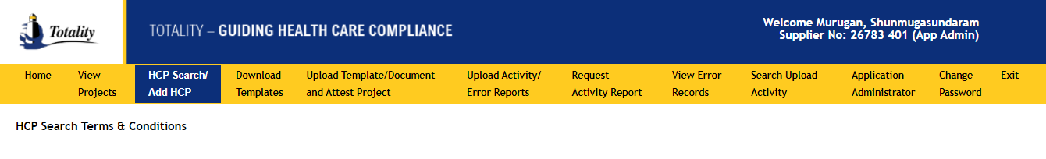
HCP Search and/or Request New HCP
Selecting the best JNJ HCP ID is the critical driver for federal and state reporting.
The search is done for Professional and Institutions.
  Professional : The best identifier to use for an individual HCP is their *National Provider Identifier (NPI) number.
  Institutions : The best identifier for a Teaching Hospital is their tax ID (EIN) number.
It is especially important when determining if the entity is a reportable teaching hospital or a licensed US practitioner who received a value transfer from J&J. (Medical Doctors, Doctor of Osteopathy, Optometrists, Podiatrists, Chiropractors, Dentists)
When selection of HCP ID is incorrect, it can and has resulted in HCP disputed transactions through Open Payments.
Let’s work together to ensure the correct selection is made therefore decreasing HCP disputes for the future.

Slide 22
Payment Arrangement / Institution vs Individual
Institution / Entity Name
  Institution/Entities can be Hospitals, Academics Institution, Group Practices, Practice Name, etc.
  NOTE: Some individuals have set up Legal Entities using their given name, i.e Dr. John Doe, LLC, Dr. John Doe, PC, John Doe, DBA as ABC Consultants, etc.
    Legal Entities will have a Tax ID# other than the individual’s social security number.
    If Not in the system by LLC, PA, Inc – then have it added.
  Ensure Payment Arrangement is accurate – either Institution or Individual.
  2017 Observation: reporting as Institution with Entity name as Dr. John doe
    Further inquiry identifies that the payment was made to an individual
  Only select Institution for a Legal Entity only using the Practitioners if the consultant has given you the tax ID for the Legal Entity; otherwise report the payment arrangement as paying an individual.

Slide 23
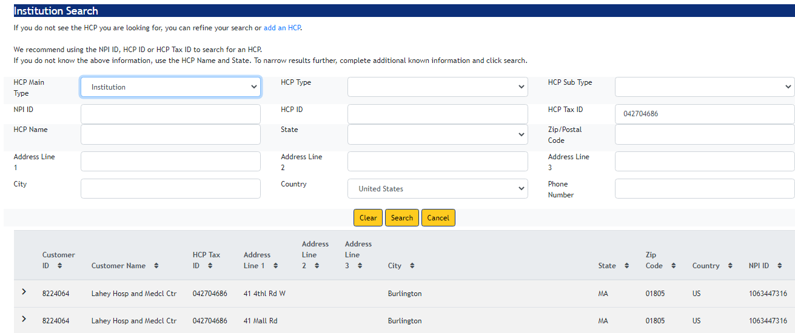
HCP Search | Institution | HCP Tax ID
For Institutions, always look up JNJ HCP ID using HCP TAX ID and state of the institution
In Totality, look up the JNJ HCP ID using the TAX ID and the state of the institution. If the Tax ID returns a match, please use the corresponding JNJ HCP ID in your transaction. The address and the name of the HCP may not be an exact match, but should be reasonably similar.
  Results can be returned with multiple pages; however, they are in alphabetical order.
  If there is not a match using Tax ID in Totality. Please use the JNJ_Teaching_Hospital_2017 list attached herewith or located on the Totality Portal.
  If the Tax ID (CMS_TIN) is located in this file use the HCP ID (JNJ_ID) associated with the CMS_TIN, or
  If the Tax ID (CMS_TIN) is NOT located in this file, complete the HCP search in Totality as you normally would and select an HCP ID (in Totality) that is NOT in the Teaching Hospital file.

Slide 24
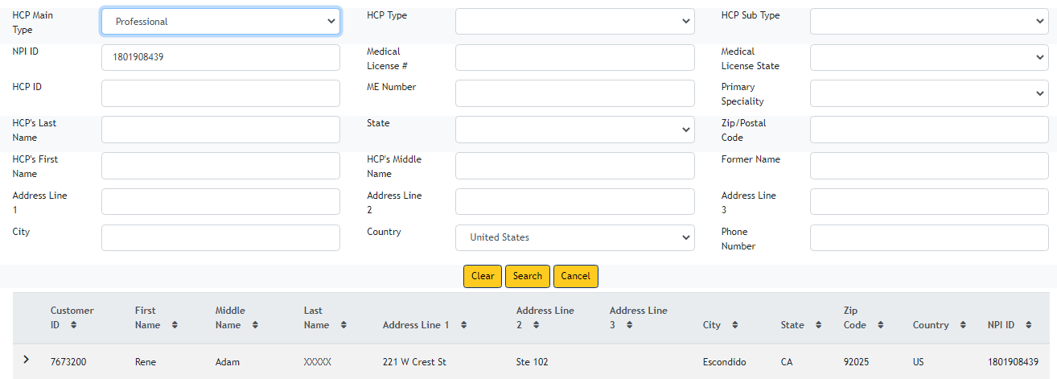
HCP Search | Professional | NPI ID
Always
Prioritize using NPI number to search HCP
NPI number is unique for HCPs in the US. It is easier to conclude referring to the NPI number.
----------------
It is very important to collect the NPI number of each HCP during registration, reservation and in sign in sheets
In Totality, look up the JNJ HCP ID using the NPI # of the licensed HCP. To obtain the NPI number, use WWW.NPIDB.org. The HCP may have licenses in multiple states. The address and the name of the HCP may not be an exact match, but should be reasonably similar; i.e. a recently married female physician or hyphenated name may not match exactly; address may not match exactly but is less important than matching the NPI#.
  Results can be returned with multiple pages; however, they are in alphabetical order.
  If there is not a match using NPI#, complete the HCP search in Totality by last name, state, etc.
  Often there are HCPs that have the same name, but have different specialties. Confirm the selected HCP aligns with:
    Appropriate specialty (i.e. John Doe, MD, not John Doe, PA
    Middle name/initial

Slide 25
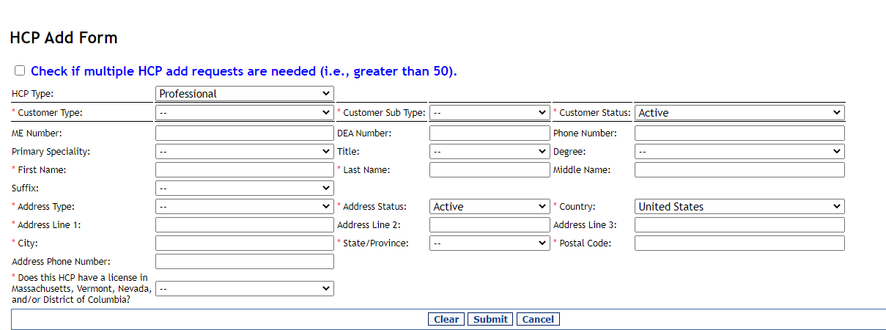
HCP Search | Add HCP
Key Points:
Prior to searching, you must ‘Accept’ the IMS & AMA terms & conditions to proceed
Confirm the HCP you select is an exact match based on key information (Address, License #, etc.)
HCP individual adds take 7-10 business days to process and bulk request takes 20 business days.
Visit the Totality 3rd Party Portal ‘HCP Search & Add Functions’ section for step-by-step instructions to search or add HCPs
Do not add a new JNJHCPID just for address change! Name should be Googled to ensure spelling is correct before an add. Reverse first/last name; Specialty. . .

Slide 26
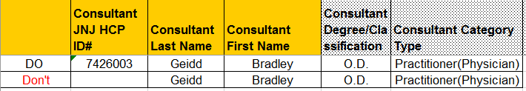
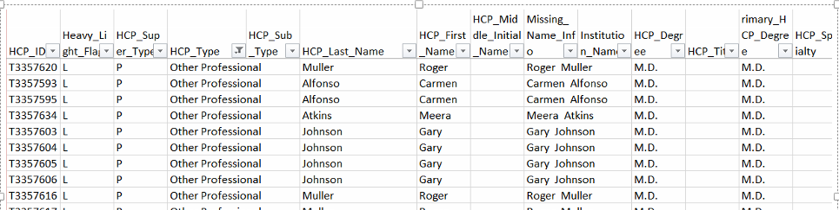
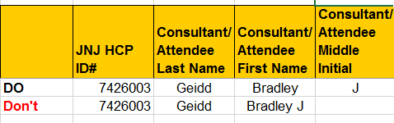
Data Integrity: Do’s & Don’ts
DO – Search for a JNJ HCPID for every HCP with a “Heavy” status (Practitioner, Mid-Level Practitioner, Resident, etc. and HCPs in identified States (i.e. MA, VT, DC, etc.).“Light”- Technician, PhD, office staff, etc.
DON’T – Leave the JNJ HCPID field Blank, causes the HCPID to be processed with a “T” temporary JNJHCP ID. Data will be returned to vendor to correct.
DO – Input Middle Name and/or Middle Initial in the “Middle Initial” field only
DON’T – Include Middle Name with First or Last Name

Slide 27
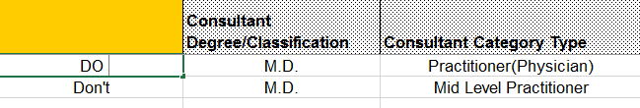
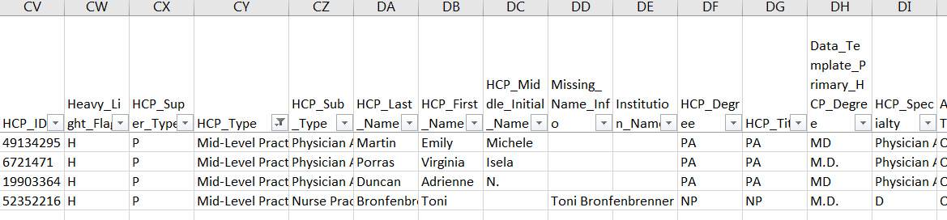
Data Integrity: Do’s & Don’ts
DO – align the HCP Type with the HCP’s Degree
DON’T – mismatch the HCP Type and the HCP Degree
DO – identify the HCP / Individual when a meal or travel is provided
DON’T– identify ONLY the Entity or Payee if other than the Individual who received the value – enter both, if appropriate . . . The entity AND/OR the Individual

Slide 28
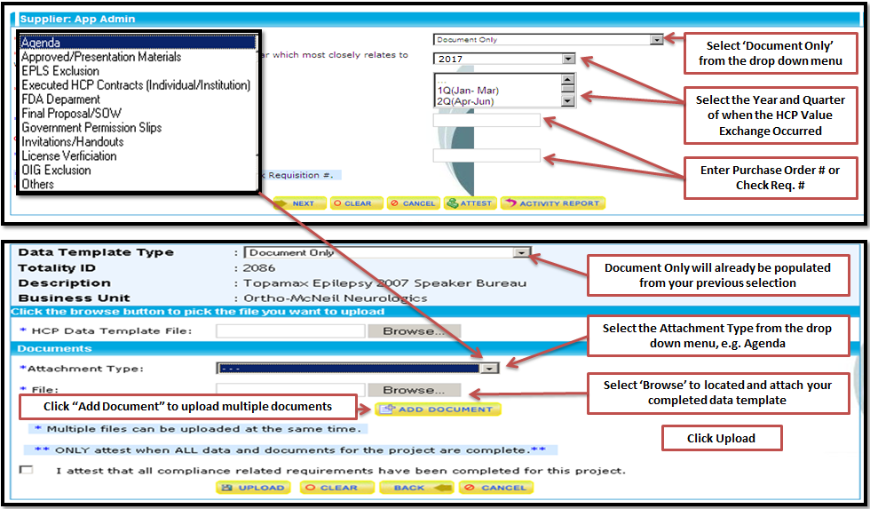
Document Only
Please refer to the below attached checklist for accurate document upload

Slide 29
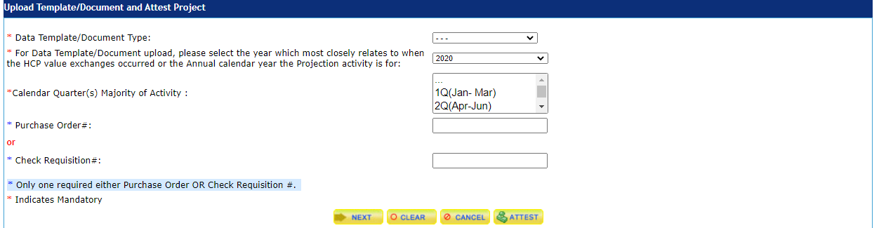
File Upload: Template
From the Menu– select the ‘ Upload Data Template/Document & Attest Project
Select the Data Template from the Drop Down Menu
Select the Year and Quarter of when the HCP Value Exchange Occurred
Enter Purchase Order # or Check Req. #
Click ‘Next’
Common Errors:
Invalid PO/CR – PO not linked to a valid Totality ID
  Confirm PO/CR Number entered is correct
  Contact J&J Project Owner to ensure PO/CR is connected to a Totality ID
Supplier ID associated with the email/user name is not consistent with the Supplier ID associated with the PO
  Contact Totality Helpdesk for resolution
  Create an new User ID consistent with the Supplier ID on the PO

Slide 30
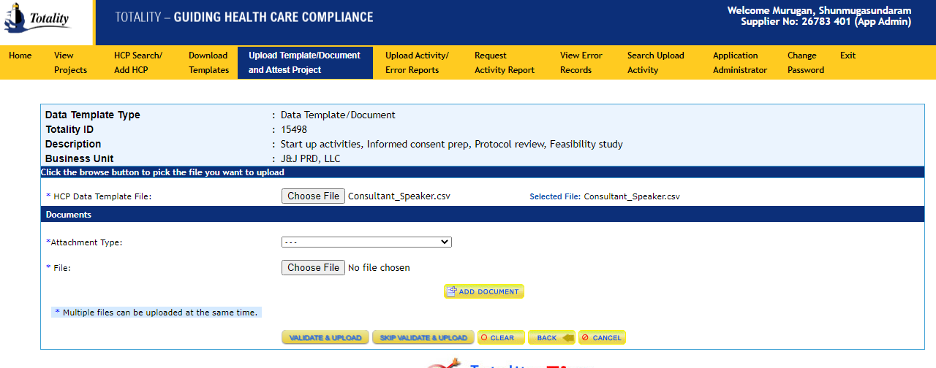
On Screen Data Validation

Slide 31
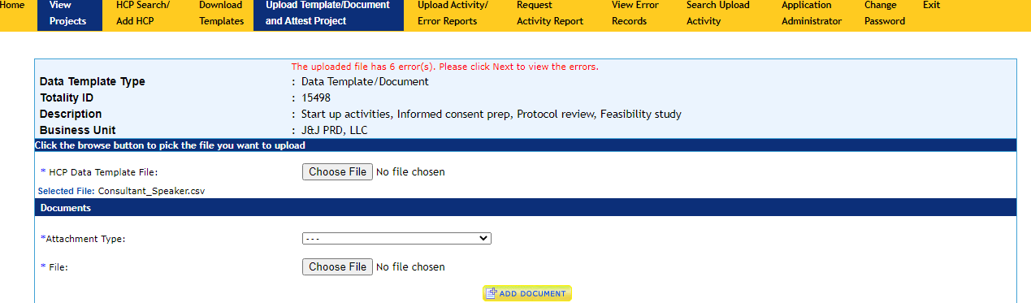
On Screen Data Validation

Slide 32
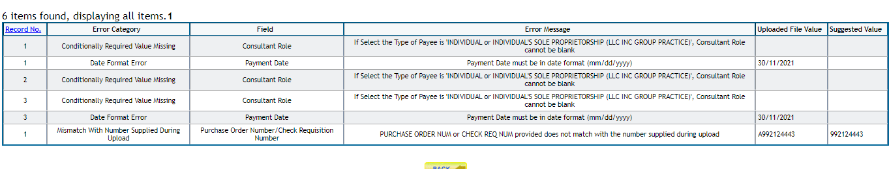
On Screen Data Validation

Slide 33
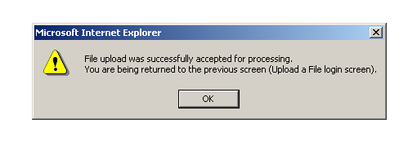
File Upload Completion
Supplier Attestation and Close Out Instruction
Successful notification of processing upon submission
System validates data three times per day
You will receive an automatic email notification that your files was process successfully or if there were errors

Slide 34
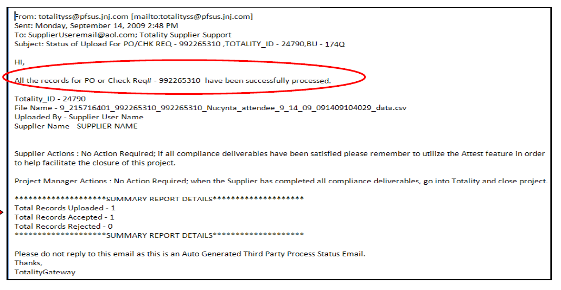
Notification Email: No Errors
Key Points:
Provides confirmation that all of the records of the uploaded data template were successfully processed
Provides a summary of the total number of records uploaded and accepted.

Slide 35
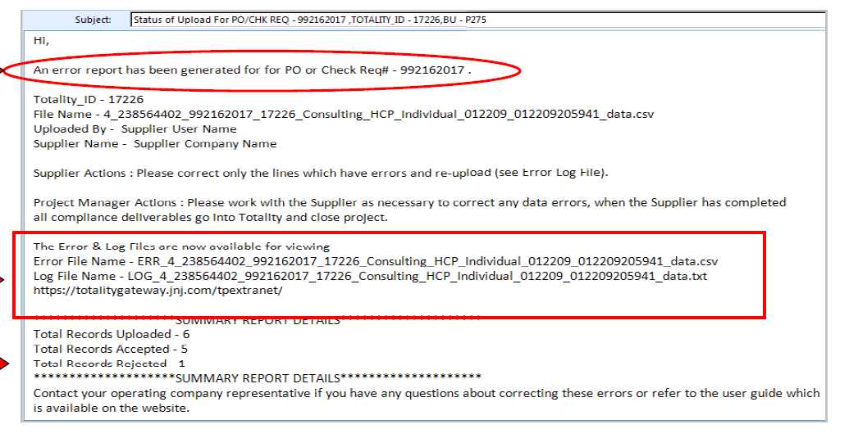
Notification Email: Validation Errors
Key Points:
Notification that some or all of the uploaded records failed validation
Provides the number of records in the file that were – Uploaded, Accepted, and Rejected
The names of the Error File and Log File that you will use to correct the errors
Only the individual lines/records of the data template that failed validation will be rejected and require correction. You only need to re-submit the rejected line items.

Slide 36
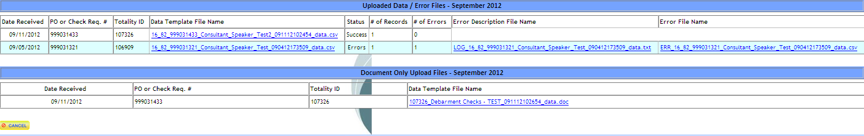
Correcting Validation Errors
File Uploaded
Upload Status
Document Only
Records/Errors
Key Points:
Upload activity reports are located in the “Upload Activity/Error Reports” section of the Totality Portal
Provides six months of historical upload activity
  File Uploads: Original file uploads in .CSV format
  Error Files: Error file/logs with description of validation errors
To view your files – select the month/year the file was uploaded and locate the file names from the error notification email

Slide 37
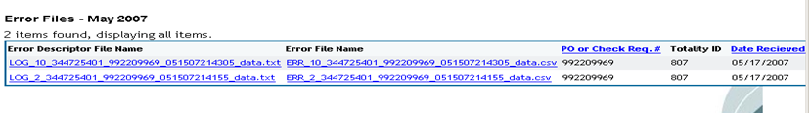
Correcting Validation Errors
Locate and open the Error Description File & Error File in the Upload Activity tab
  Refer to the error description file to identify the errors that need to be corrected
  NOTE: Column A of the Error File is a system generated column to assist in identifying the record/line in the Error Description File
The error file contains only records from the original data template that had validation errors. All other records were uploaded successfully.
To correct the errors: Copy and Paste the records from the error file into a new data template.
  Correct the errors that were noted in the Error Description File
  Use the verify data button to confirm errors have been corrected and required fields are populated
Select the ‘Data Template/Document Upload’ link from the home page and follow the normal upload process.
Provides text description of lines that failed during the validation process
Provides the lines/records from the uploaded template that had errors

Slide 38
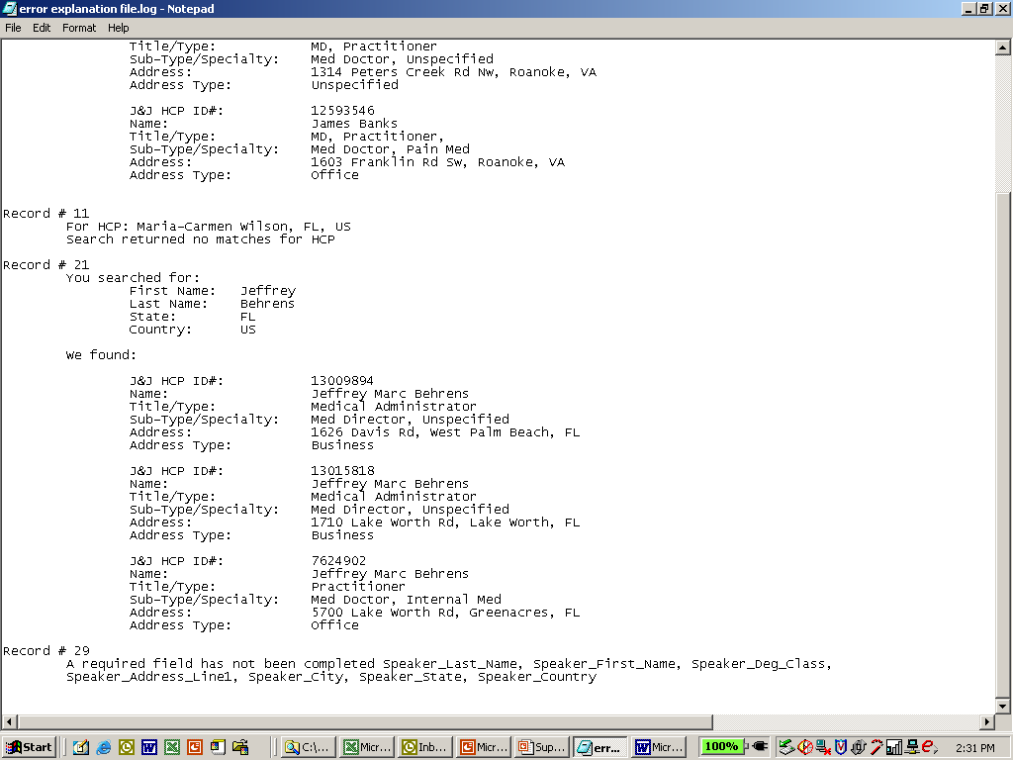
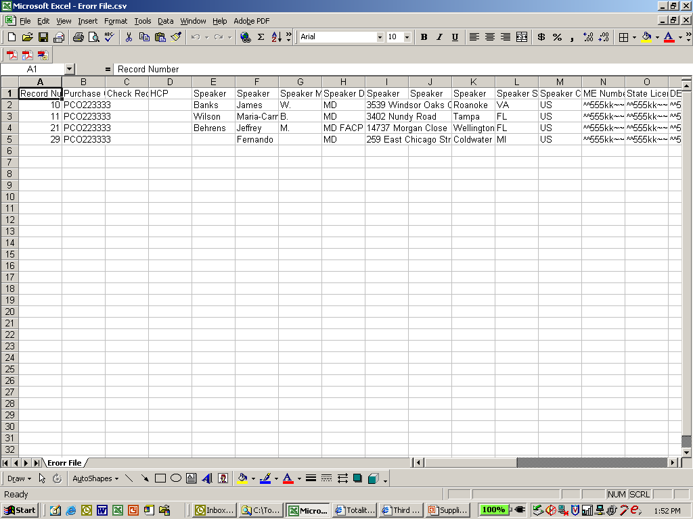
Correcting Validation Errors
Error Description File
Error File
Error File:
Column A provides the record/row number from the original data file that is in error.
You can cross reference this number with the record number in the error description file to identify the validation errors.
REMEMBER to delete column A when resubmitting the corrected file

Slide 39
Correcting Validation Errors: Common Errors
Kindly Ensure
All error logs are rectified.
Ensure all data and documentations are uploaded correctly.
Data Deletion is processed for all incorrect or duplicate records.
Invalid Date Formats
Template submitted without J&J HCP ID Number
HCP Address does not agree with the J&J HCP ID # supplied
Required fields left blank.
Zero was used in a field – always leave blank if no value
PO # must be a numeric 9-digit entry and match the PO # entered on the upload screen
Company Paid vs. Direct Reimbursable Expenses – If only Direct Reimbursable expenses/fields are completed on a template (no company paid expenses), the “Read Company Paid Expense” field must include “N” indicating that ONLY the reimbursable fields will include dollar amounts.
When uploading correction file, file name should be similar but include a v1 or word "correction", etc.
Submission of all data from original template – ONLY lines/records with errors should be resubmitted for processing.
Quick Tips:
Request an Activity/Closeout Report to ensure ALL information uploaded is accurately reflected.
  Always check for missing, inaccurate, or duplicate data.
If you continue to receive template errors, try a “fresh” new template and resubmit for processing

Slide 40
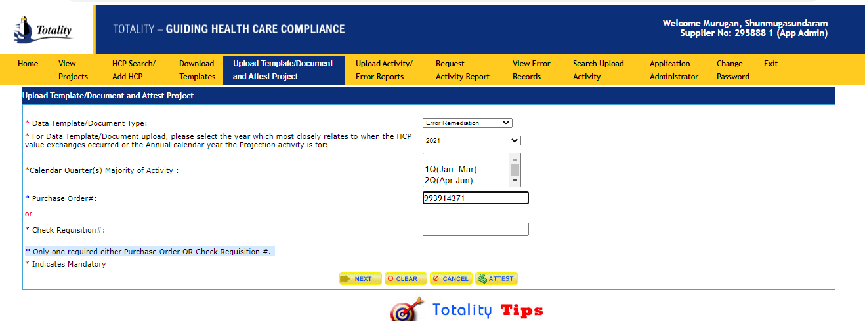
error remediations

Slide 41
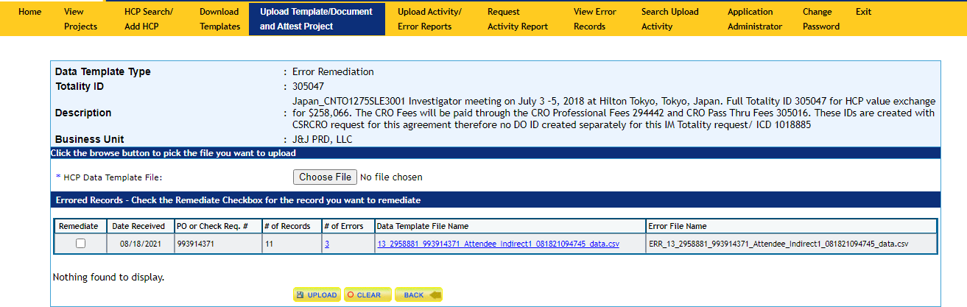
error remediations

Slide 42
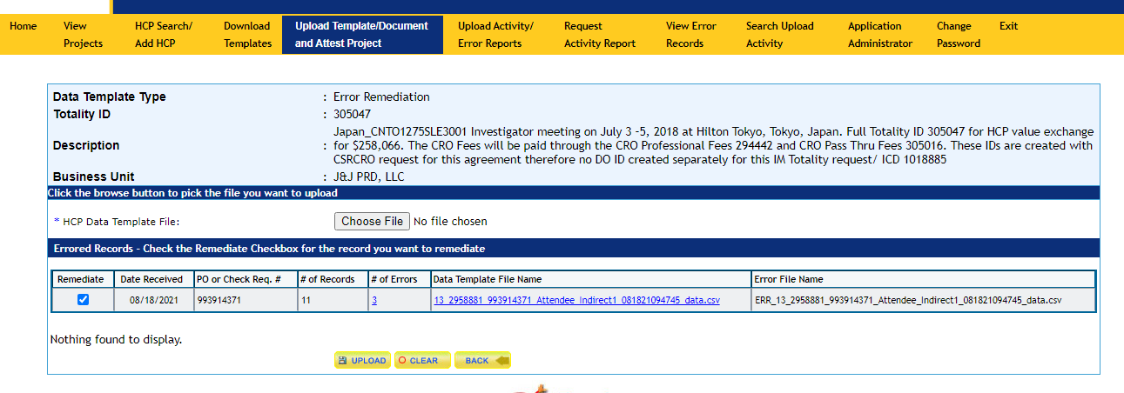
error remediations

Slide 43
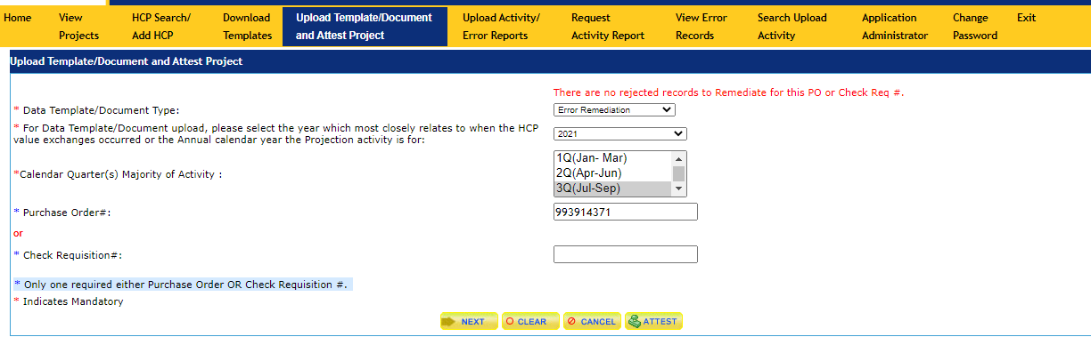
reconcile error remediations to original uploaded Value Transfer transactions
After remediating all the errors

Slide 44
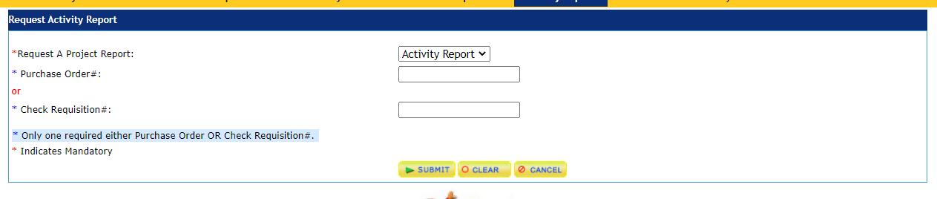
Activity Report: Running a Report
Click the ‘Request an Activity Report’ link from the Totality Home Page
Activity Reports contain all information that was previously uploaded via the data templates.
  Activity reports can be run at any time to ensure the data uploaded is accurately reflected.
  Activity reports MUST be run at the end of a project and prior to attesting to ensure data is accurately reflected prior to project closeout.
Activity Reports are generated by PO # and may include other PO #’s associated with the Totality ID
Enter PO or CR#
Note: Once submitted, you will receive your activity report within 2-3 hours to the email address associated with your login.

Slide 45
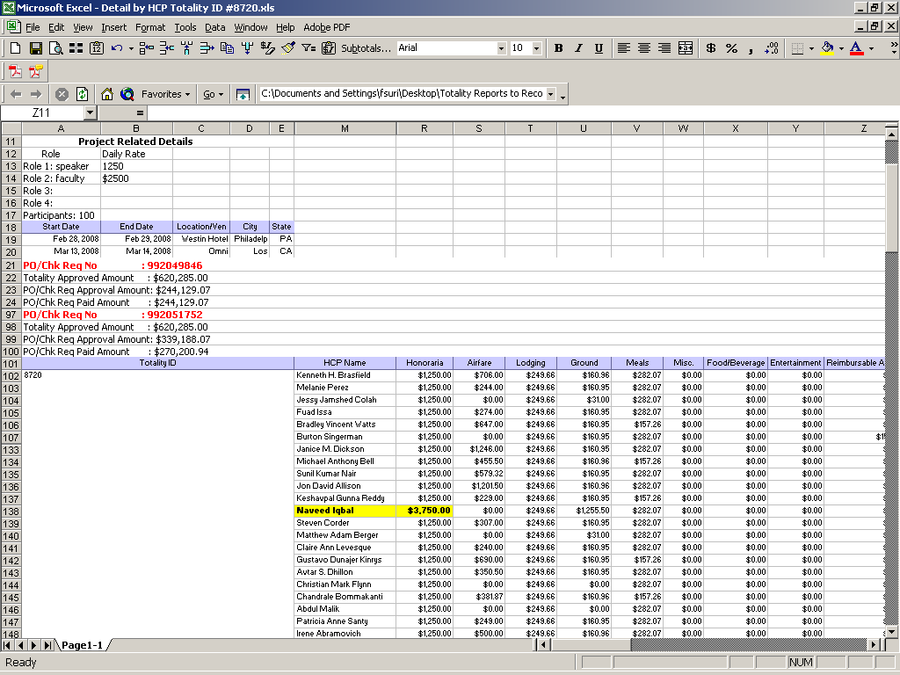
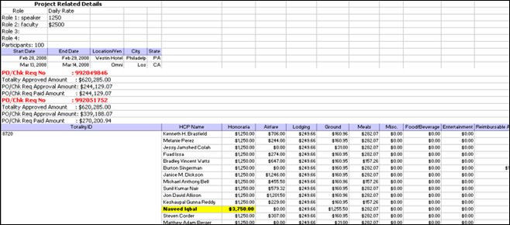
Activity Report: Detail Report View
Details of Individual HCP Expenses – Import to review for the following:
Payment Amounts – review for outlying data that may have been incorrectly entered
Duplicate Data – review line items to ensure no duplicate records were processed
Ensure all ALL data is accurately captured and no data is missing
If errors or duplicate data are identified, please notify your J&J Project Manager and complete a “Data Deletion Request Form” located on the Supplier Resource Site, under the ‘Form’ section.
If errors are identified, you will need to complete a new Data Template for those individual lines and resubmit

Slide 46
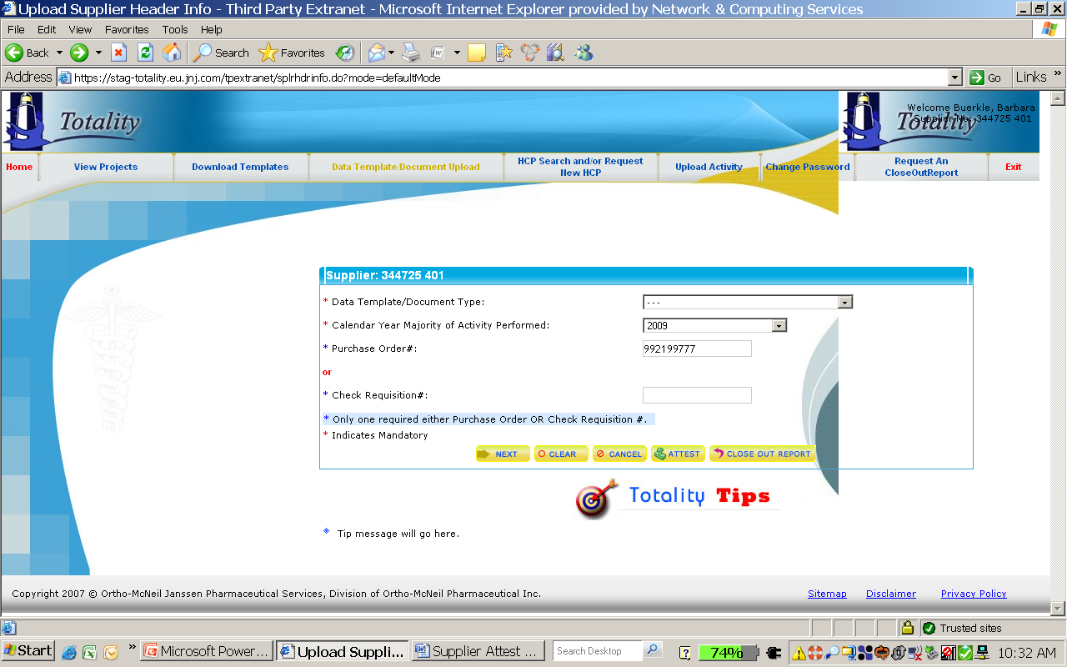
Project Closeout: Supplier Attestation
After compliance deliverables are met, the Supplier must “Attest”
Project Attestation includes two parts:
  That you reviewed the Activity Report and all data is complete and accurate
  That all compliance related requirements for the project have been met/completed
From the Totality Home Page, select the “Data Template/Document Upload and Project Attestation” link
Supplier Attestation and Close Out Instruction
Final Project Attestation Process
Select the year that the majority of activity occurred
Enter PO Number
Click the “Attest” Button

Slide 47
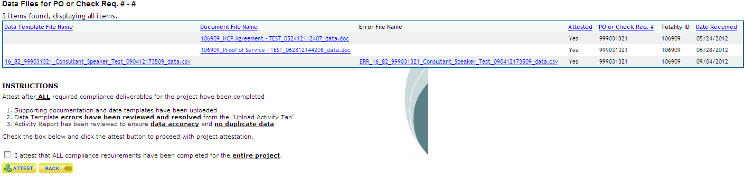
Project Closeout: Supplier Attestation
Once you click “Attest” you will have the ability to view all uploaded documents and whether or not they were previously attested
Uploaded Documents
Upon confirmation that ALL deliverables are accurately uploaded, you may “Attest” by checking the box above and click the “Attest” button
Once you attest, the J&J Project Owner will receive a notification that you have attested and they will review all of the documentation to ensure all deliverables are accurately captured

Slide 48
Project Closeout: Closed Project
Closed transactions associated with an individual supplier can be found on the “View Projects” tab within the Totality site
Once a transaction is “Closed”, you will not be able to upload anymore data templates or documents
Suppliers must contact the J&J Project Manager to re-open a project if additional uploads or template data corrections are required

Slide 49
Upload Review and Data Deletion Process
Supplier Upload Review:
  Suppliers are required to review all uploaded data (including templates and supporting documents) for completeness and accuracy, and to ensure that there are no duplicates, and that data is accurate for Federal and State reporting.
Data Deletion:
  The HCP data deletion request is processed to remove duplicate and incorrect information that were submitted.
  In the event that inaccurate or duplicate data is identified, suppliers are required to submit a data deletion request and reupload any corrected data.

Slide 50
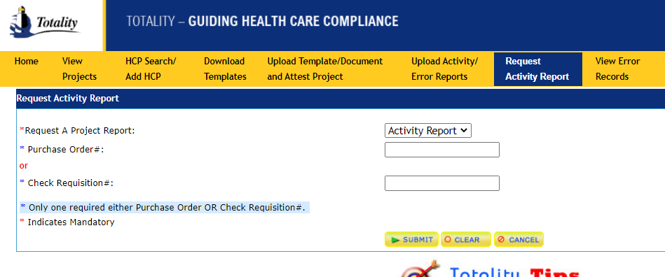
Data Deletion Request Process
“Request an Activity Report” for the project and review to validate that all uploaded HCP data is complete and accurate.
  Go to “Request an Activity Report” tab on the Extranet.
  Enter the PO Number for the project.
  An Activity Report that provides the details of all validated upload activity (and documents) for the project will be emailed to the User within 1 hour.

Slide 51
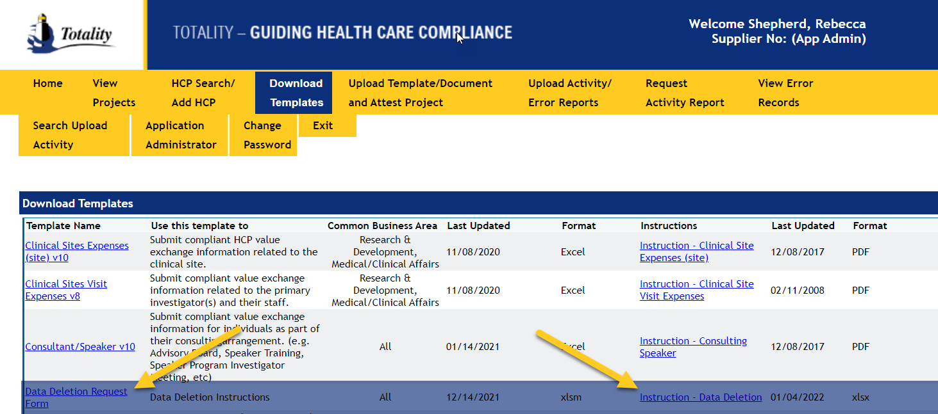
Data Deletion Request Process
Supplier Upload Review:
If errors or duplicate records are identified on the report, complete the Data Deletion Request Form found on the Download Templates section of the Totality Third Party Portal. The Data Deletion Instructions can be found on the same page.

Slide 52
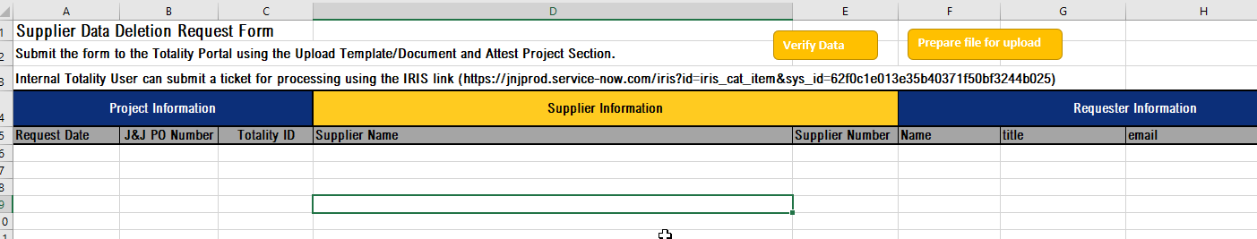
Data Deletion Request Process
Data Deletion:
  The HCP data deletion request is processed to remove duplicate and incorrect information that were submitted.
  If inaccurate or duplicate data is identified, suppliers are required to submit a data deletion request and reupload any corrected data.
The information needed to complete the form (i.e., File Name, File ID Number and Record Number of each line to be deleted) can be found in the columns at the end of the Activity Report. The Data Deletion Instructions can be found on the Download Templates section of the Totality Third Party Portal

Slide 53
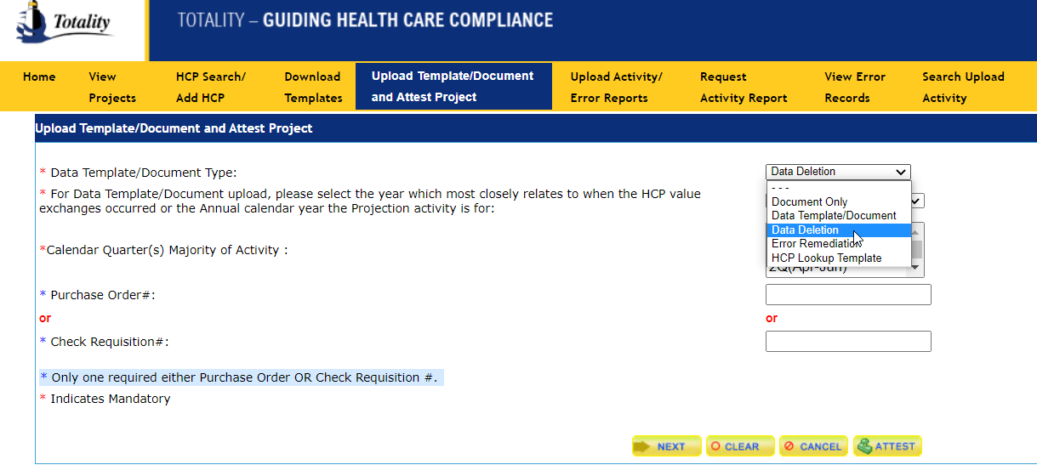
Data Deletion Request Process
Data Deletion Upload
Once you have completed the Data Deletion Request Form, go to the Upload Template/Document and Attest Project Section. Select Data Deletion in the drop-down menu, fill in the Calendar and Purchase Order information, and select Next. You will then be able to select your completed Data Deletion Request Form via the Browse and attach and upload the Form.

Slide 54
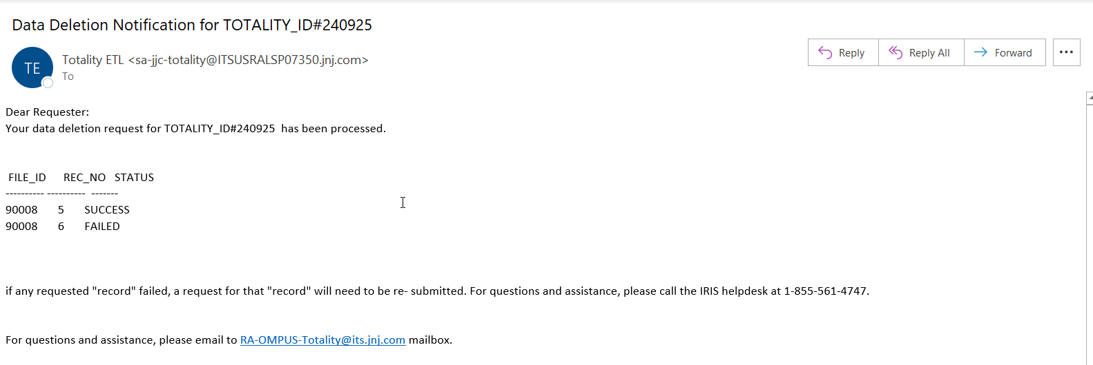
Data Deletion Request Process
Once the data deletion process is completed; the requestor will receive a confirmation email about the completion.
Upon receipt of the email confirmation, the supplier/requestor must re-run the Activity Report to validate the accuracy of the Final data.

Slide 55
Key Takeaways
Understanding of Totality and your responsibilities as a J&J Supplier
Compliance deliverables with associated timelines
Resources available to make Totality a smooth and compliant process
  Supplier Totality Portal (https://totalitygateway.jnj.com/tpextranet/inhome.do)
  Supplier Resource Portal (http://www.totalitygatewayresources.com/)
  J&J Business Partners (Project Manager, J&J Totality Team)

Slide 56
Resources: J&J Helpdesk Submission
IRIS Help Desk
  Contact with technical issues or if you’re receiving any type of system error
  Phone: US: 1-855-561-4747
    Select language of communication
    External user should enter “0” when asked for WWID
    Then choose option 4 for Business Application Support after listening to voice prompt; this will connect to Helpdesk assistant. Who will assist in creating a ticket.
    Further instruction according to your request will be provided by the Helpdesk assistant.
Screen Shots should be provided when inquiring about error messages received
Email inquiries automatically assigned ‘Medium’ Priority
  If request is high priority, add ‘High’ to the subject line
Escalate unanswered emails/voicemails to the HCC Totality Team (your JNJ Totality contact)

Slide 57
Resources: J&J Totality Experts
Totality Project Related Questions:
  Your J&J Totality Project Manager
J&J Extranet Resources:
  Supplier Totality Portal: https://totalitygateway.jnj.com/tpextranet/
  Supplier Resource Portal: http://www.totalitygatewayresources.com/
Totality Process Related Questions:
  HCC Totality Support
    hcctotalityhelp@its.jnj.com
  Becky Shepherd
    RShephe1@ITS.JNJ.com

Slide 58
QUESTIONS

Slide 59
Reference Documents
http://www.fda.gov/ICECI/EnforcementActions/FDADebarmentList/default.htm
http://www.ama-assn.org/ama/pub/education-careers/becoming-physician/medical-licensure/state-medical-boards.page
http://exclusions.oig.hhs.gov/
https://www.epls.gov/epls/search.do

Slide 60
THANK YOU

